Slide 1
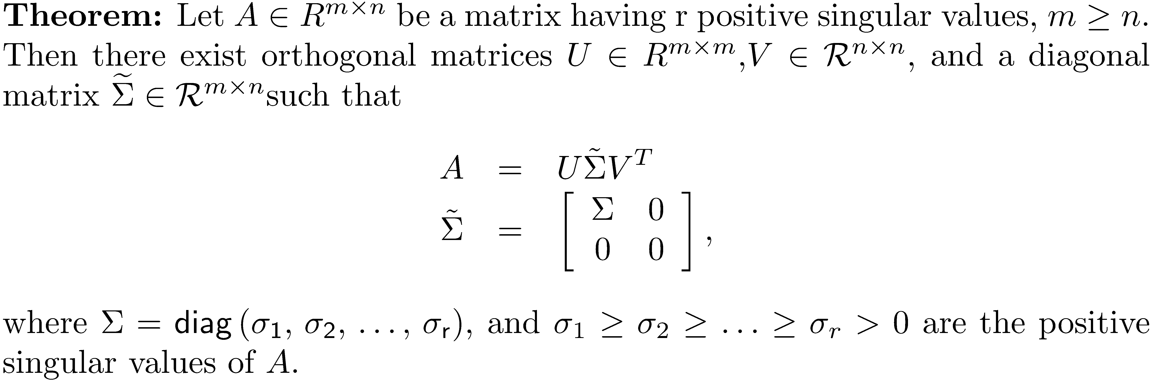
The Singular Value Decomposition Theorem

Slide 2
Singular Value Decomposition Theorem Proof Outline
The proof is by construction:
Build the m × n matrix by placing the positive singular values on the diagonal of Σ in descending order, so
NOTE: If A is singular, there will be one or more zero singular values, so r may be less than n.
Find an orthonormal basis v_{i} ,1 ≤ i ≤ n, of eigenvectors of A^{T}A . This can be done because A^{T}A is symmetric (spectral theorem).

Slide 3
Singular Value Decomposition Theorem Proof Outline
Let the orthonormal form the first r columns of U. If r < n, n-r additional vectors are required to form . To find these, successively add a standard basis vector and apply Gram-Schmidt.
NOTE: The addition of n-r vectors can be done many ways, so U is not unique. Neither is V.
A computation shows that

Slide 4
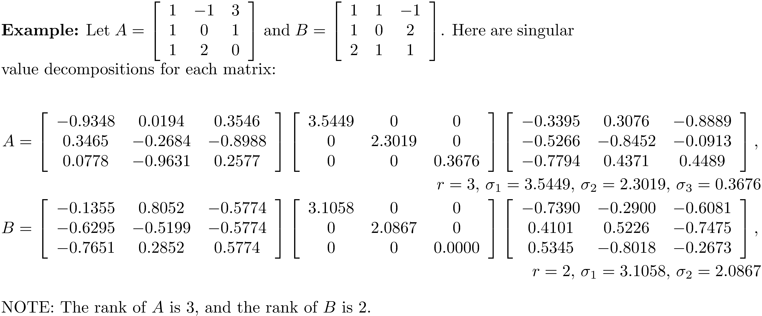
Example 1

Slide 5
The SVD if m < n
The n × m matrix AT has full rank, so and

Slide 6
Using the SVD to Determine Matrix Rank
A necessary theorem:
The rank of a matrix A is the number of nonzero singular values.
Proof: Let be the singular value decomposition of A. Orthogonal matrices are invertible, so from the theorem is a basis for the column space of , so the rank of is r.

Slide 7
Using the SVD to Determine Matrix Range
The range of A is the column space of A.
The u_{i}, 1 ≤ i ≤ r, are an orthonormal basis for the range of A.

Slide 8
Using the SVD to Determine Matrix Null Space
The null space of a matrix is the set of all vectors x such that Ax = 0.
The n-r vectors v_{i}, r+1 ≤ i ≤ n, is an orthonormal basis for the null space of A. NOTE: r + (n-r) = n.

Slide 9
Basis for the Row Space of A
The range of A^{T} is the row space of A.
The v_{i}, 1 ≤ i ≤ r, are an orthonormal basis for the row space of A. Since v_{i}, r+1 ≤ i ≤ n, is an orthonormal basis for the null space of A, it follows that all vectors in the row space are orthogonal to all the vectors in the null space.

Slide 10
Basis for the Null Space of A^{T}
The vectors u_{i}, r+1 ≤ i ≤ m, are an orthonormal basis for the null space of A^{T}. It follows that the vectors in the null space of A^{T} are orthogonal to the vectors in the range of A.

Slide 11
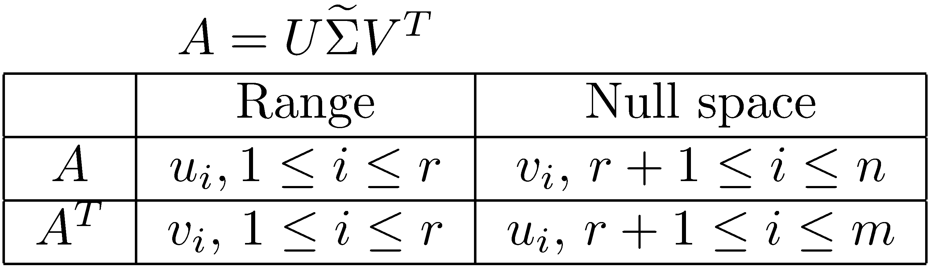
The Four Fundamental Subspaces of a Matrix
The range of A and A^{T}, and the null space of A and A^{T} are known as the four fundamental subspaces of a matrix.
Orthogonal subspaces
Orthogonal subspaces

Slide 12
Example 2
Let . The SVD of A is

Slide 13
Example 2
Singular values:
rank = r = 3.
Basis for the range:
Basis for the null space:
Basis for the row space:
Basis for the null space of A^{T}:

Slide 14
Row Rank = Column Rank

Slide 15
SVD and the Frobenius Norm
Proof:

Slide 16
Geometric Interpretation of the SVD
Look at the effect of A^{m × n}x, where x varies over the n-dimensional unit sphere

Slide 17
Geometric Interpretation of the SVD
If A is an m × n matrix, then Ax applied to the unit sphere in is a rotated ellipsoid in with semiaxes σ_{i}, 1 ≤ i ≤ r, where the σ_{i} are the nonzero singular values of A.

Slide 18
Example 3
The MATLAB function svdgeom demonstrates the action of a linear transformation on the unit circle. Let
>> svdgeom(A)
The singular value decomposition for A is
U =
-0.4560 -0.8900
-0.8900 0.4560
S =
10.2961 0
0 2.2339
V =
-0.5629 0.8265
0.8265 0.5629

Slide 19
Computing the SVD using MATLAB
[U S V] = svd(A);
S = svd(A);
svd(A)
Computes all three SVD components.
Computes just the singular values.
Prints the singular values.

Slide 20
Example 4
Let
>> [U,S,V] = svd(A)
U =
-0.4472 0.8944 0.0000 0.0000 0.0000
-0.4472 -0.2236 -0.5000 -0.5000 -0.5000
-0.4472 -0.2236 -0.1667 -0.1667 0.8333
-0.4472 -0.2236 -0.1667 0.8333 -0.1667
-0.4472 -0.2236 0.8333 -0.1667 -0.1667
S =
5.0000 0 0 0 0
0 0.0000 0 0 0
0 0 0 0 0
0 0 0 0 0
0 0 0 0 0
V =
-0.4472 0.8944 0 0 0
-0.4472 -0.2236 -0.0000 -0.0000 0.8660
-0.4472 -0.2236 -0.5774 -0.5774 -0.2887
-0.4472 -0.2236 -0.2113 0.7887 -0.2887
-0.4472 -0.2236 0.7887 -0.2113 -0.2887
A is called a rank 1 matrix.

Slide 21
Computing A⁻¹
The inverse is often difficult to compute accurately and that, under most circumstances, its computation should be avoided. When it is necessary to compute A⁻¹ , the SVD can be used.
Since A is nonsingular, A has n nonzero singular values, and

Slide 22
Example 5
Let
>> [U,S,V] = svd(A);
>> Ainv = V*diag(1./diag(S))*U'
Ainv =
0.5206 -0.1573 0.2509 -0.1161
0.0468 -0.0393 -0.0206 0.0543
0.1916 -0.0543 -0.0443 -0.0044
-0.0243 0.1404 -0.0693 0.0918
>> inv(A)
ans =
0.5206 -0.1573 0.2509 -0.1161
0.0468 -0.0393 -0.0206 0.0543
0.1916 -0.0543 -0.0443 -0.0044
-0.0243 0.1404 -0.0693 0.0918

Slide 23
Image Compression
Image compression is minimizing the size of a graphics file without reducing the quality of the image to the eye. Compression reduces redundancy and irrelevant data.
Simple compression can be done using SVD. The idea involves using only portions of the SVD that involve the larger singular values, since the smaller singular values do not contribute much to the image.

Slide 24
Rank 1 Matrix
Using the SVD for image compression involves the concept of a rank 1 matrix.
A rank 1 matrix is a matrix with only one linearly independent column or row.
Example: is a rank 1 matrix.
The primary idea in using the SVD for image compression is that a matrix A can be written as a sum of rank 1 matrices, each matrix corresponding to a singular value.

Slide 25
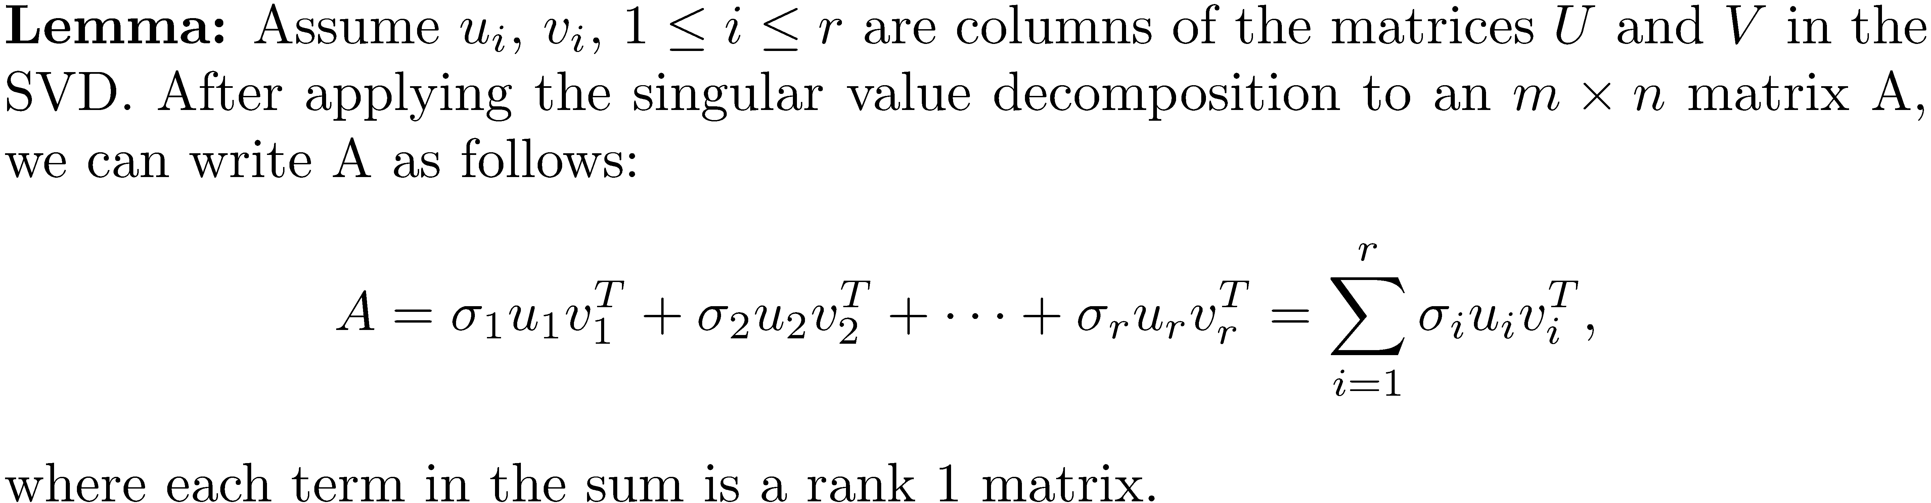
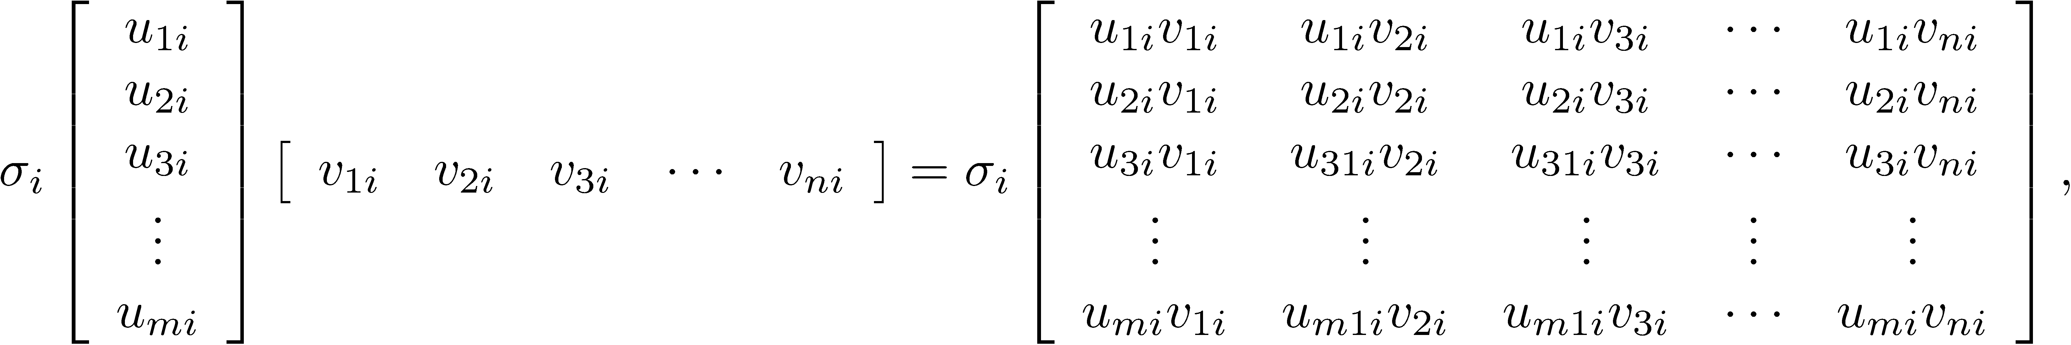
Rank 1 Matrix
Each portion of the sum has the form and each column is a multiple of the vector so each matrix has rank 1.

Slide 26
Modes
Each term is called a mode, so we can view an image as a sum of modes.
Because the singular values σ_{i} are in the decreasing order σ₁ ≥ σ₂ ≥ … ≥ σ_{r}, significant compression of the image is possible if the set of singular values has only a few large modes, say σ₁, σ₂, …, σ_{k}. Form the sum of those modes, and it will be a rank k matrix indistinguishable from the original image.

Slide 27
Simple MATLAB Image Handling
Type >> C = 1:64; >> image(C);
Each entry in the matrix corresponds to a small square of the image. The numerical value of each entry corresponds to a color in MATLAB. What you see is a color spectrum.

Slide 28
Simple MATLAB Image Handling
Generate a 3 x 3 square of randomly generated colors. >> I = randi(64,3,3); >> image(I);

Slide 29
Simple MATLAB Image Handling
General image processing with MATLAB is somewhat complex, so we will confine ourselves to operations with gray scale images.
Repeat the previous example by forcing gray scale. This is done by setting the colormap to gray.
>> I = randi(64,3,3);
>> image(I);
>> colormap(gray);

Slide 30
Image Compression using the SVD
In order to use the SVD for working with images, you must input the file using the command imread.
The extension “ext” can be one of many possibilities, including “tif/tiff”, “bmp”, “gif”, “jpg”, and so forth.
>> A = imread('filename.ext');

Slide 31
Image Compression using the SVD
Display the image with the commands “imagesc” scales the image so it uses the full colormap and displays it. For gray scale, the MATLAB colormap is gray.
>> imagesc(A);
>> colormap(gray);

Slide 32
Image Compression using the SVD
After reading the file into the matrix A , the data type of its elements must be converted from uint8 (unsigned 8-bit integers) to double so the SVD can be applied to the matrix A.
>> A = double(A);

Slide 33
Image Compression using the SVD
Apply the SVD, compute the sum of the first k modes, and apply the SVD.
>> [U,S,V] = svd(A);
>> Aapprox = U(:,1:k)*S(1:k,1:k)*V(:,1:k)';
>> imagesc(Aapprox);
>> colormap(gray);

Slide 34
Example 6
>> JAGUAR= imread('jaguar.jpg');
>> JAGUAR= double(JAGUAR);
>> imagesc(JAGUAR);
>> colormap(gray);
>> [U, S, V] = svd(JAGUAR);
>> rank(JAGUAR)
ans =
640

Slide 35
Example 6
>> figure(2);
>> % use 100 modes
>> JAGUAR100 = U(:,1:100)*S(1:100,1:100)*V(:,1:100)';
>> imagesc(JAGUAR100 );
>> colormap(gray);

Slide 36
Example 6
Ratio of compressed image to the original image is

Slide 37
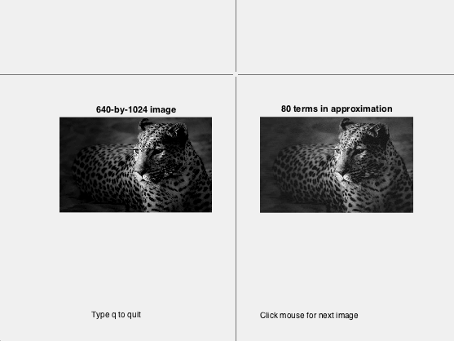
Example 7
Display the image while adding modes with each click. Stop by typing 'q'.
>> load JAGUAR;
>> svdimage(JAGUAR, 70, gray);

